Slide 1
Vibration Analysis of Robotic Arm Using MATLAB
Second Review - October 2020
TEAM MEMBERS:-
1. SWAPNANIL GOSWAMI (18130034)
2. SHARATH SUNDAR T (18130035)
3. DIAS HANSEL GAVIN (18130055)
4. V.VENKATA GOUTHAM (18130068)
PROJECT GUIDE
Dr. Nakandhrakumar
Assistant Professor (Sel.Gr.)/ANRO

Slide 2
Work Progress and Management

Slide 3
Work Distribution of team members:-
Swapnanil Goswami (presentation, mathematical modelling, Research regarding project material, Planning, simulation)
Sarath Sundar T (Research regarding project material, combining all tasks, preparing presentation)
Dias Hansel Gavin ( Presentation, Research regarding project material, simulation)
V.Venkata Goutham (presentation, mathematical modelling, Research regarding project material, CAD designing of the arm.)

Slide 4
Aim of the project
The aim of our project is to design a 5 D.O.F robotic arm and perform vibration analysis using MATLAB
To determine a Mathematical model for the simulation
To get familiar with MATLAB software and tools.

Slide 5
Problem formulation :
The main justification of our project is to learn to perform vibrational analysis on structures, also to understand how mathematical modeling is used for doing simulation with MATLAB
Another reason for carrying out this project is that we could identify unnecessary vibrations present in the arm so as to reduce it for achieving better accuracy .

Slide 6
REVIEW OF LITERATURE AND SELECTION OF REFERENCE PAPERS

Slide 7
Review of the literature
Sl.No | Title of the paper | Details of the paper | Inference from the paper
1 | VIBRATIONS by Balakumar Balachandran | This book has been written to enable the use of vibration principles in a broad spectrum of applications and to meet the wide range of challenges faced by system analysts and designers. T | this book mentions how to convert a simple model into a mass damper system for different Degrees Of Freedom
2 | Modeling and Simulation of 5DOF Robot Manipulator and Trajectory using Matlab and CATIA | Zhou Ji-Pin, Zhang Yi-hua Mechanical Engineering College Yangzhou University Yangzhou, Jiangsu, China e-mail: jpzhou@yzu.edu.cn.946516786@qq.com | This paper has helped us perform the forward kinematics using matlab
3 | VIBRATION AND KINEMATIC ANALYSIS OF SCARA ROBOT STRUCTURE | Talib EH. Elaikh 1 KadhimKarim M 5 , 4 Salah M. Swadi College of Engineering, Mustansiria 4 College of engineering, Thi-Qar University. | This paper helped us get an idea about vibrational analysis on robots.DH parameters for kinematic analyasis .

Slide 8
Review of the literature contd.
By reviewing various papers on vibration analysis, we got a brief idea about the procedure to do the analysis
Identifying all the parameters for the structure (e.g. D.O.F,etc)
Mathematical modelling w.r.t. to the parameters
Derivation of kinematic Equations
Solution of the equations
Integration of equation with MATLAB
Interpretation of the results

Slide 9
Objectives and methodology of proposed work
The objective of this work is modeling and analysis of 5DOF robotic arm manipulator by MATLAB software.
This vibrational analysis will help us improve the arm structure for achieving better accuracy without any error and also identify any unbalanced forces present in the structure.

Slide 10
The robotic arm while doing its task is subject to constant vibrational forces hence affecting its accuracy and precision.
A simple case scenario can be a spot welding robot which has to perform its task at utmost accuracy and precision, but if the arm is under constant vibration the job done will be poor and also affect the structural integrity of the job..

Slide 11
Progress of Project

Slide 12
Solid works Model of 5 D.o.f robotic arm
.

Slide 13
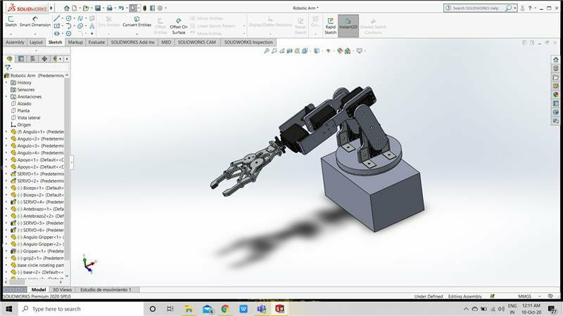

Slide 14
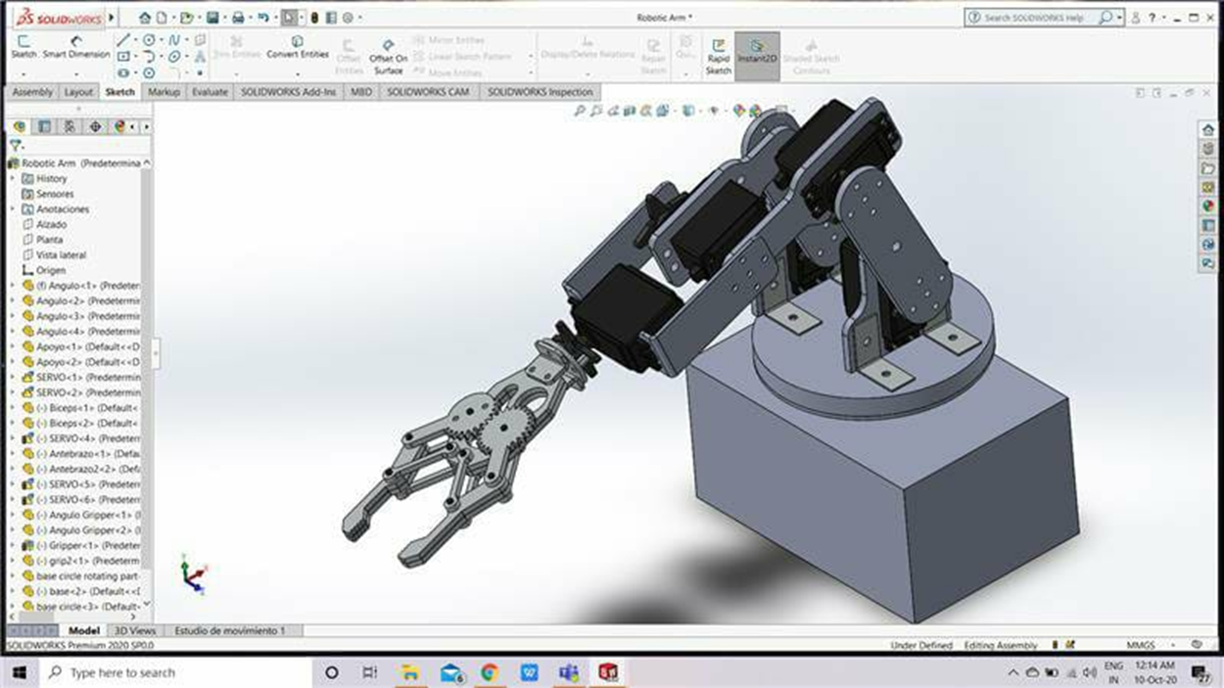

Slide 15
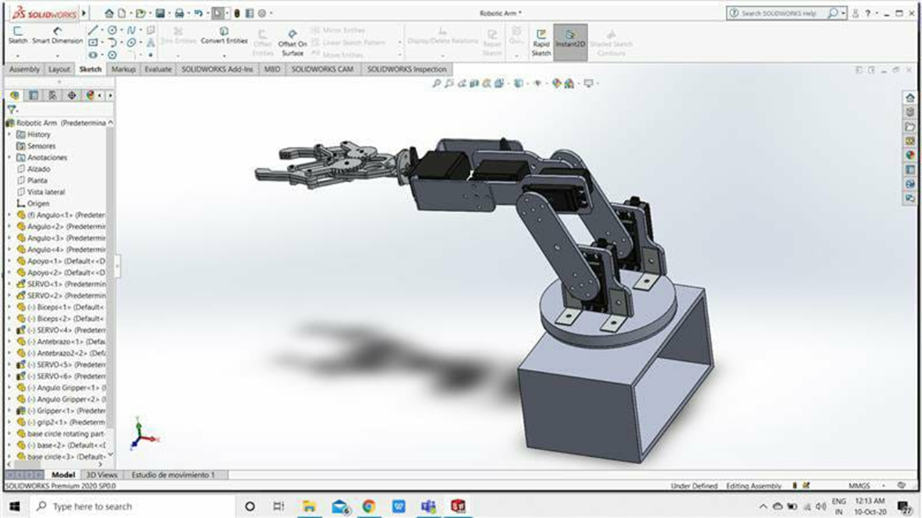

Slide 16
Rough Mathematical and Vibrational Models

Slide 17
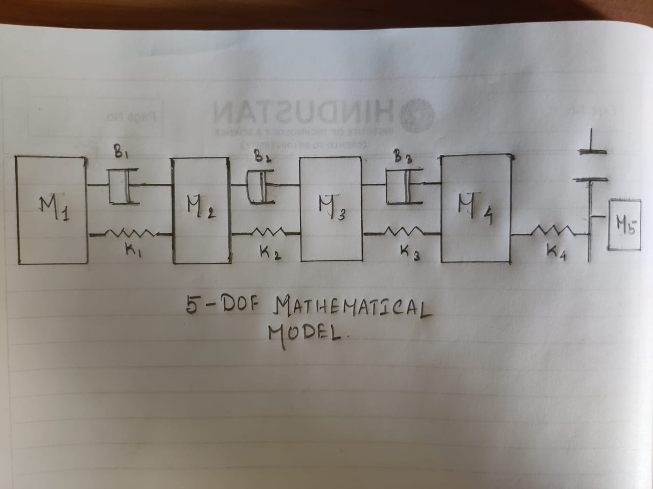

Mathematical Model

Slide 18
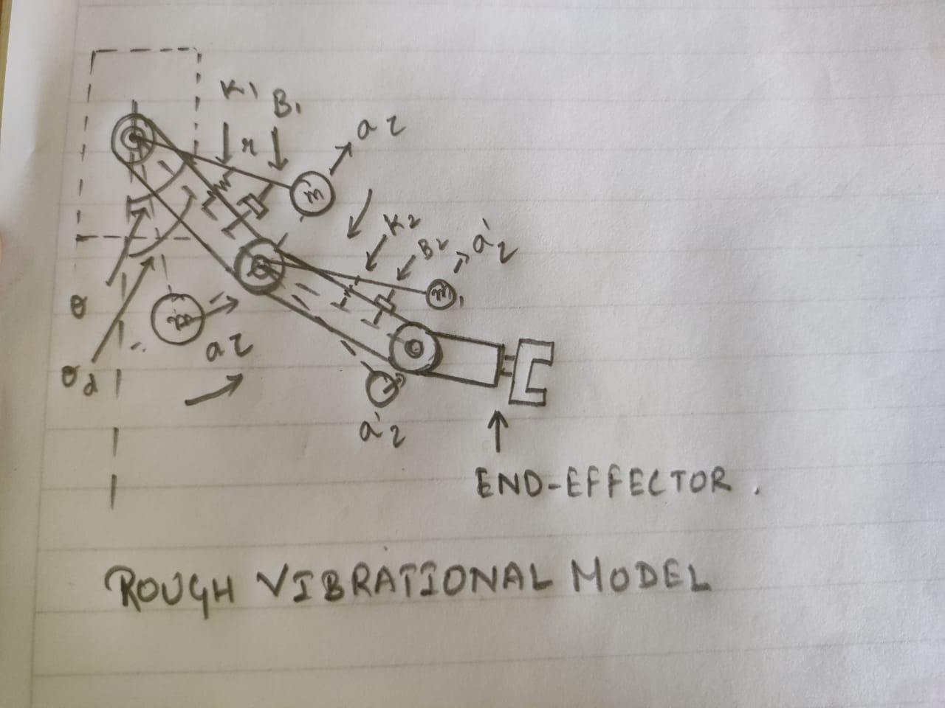
Vibrational Model

Slide 19
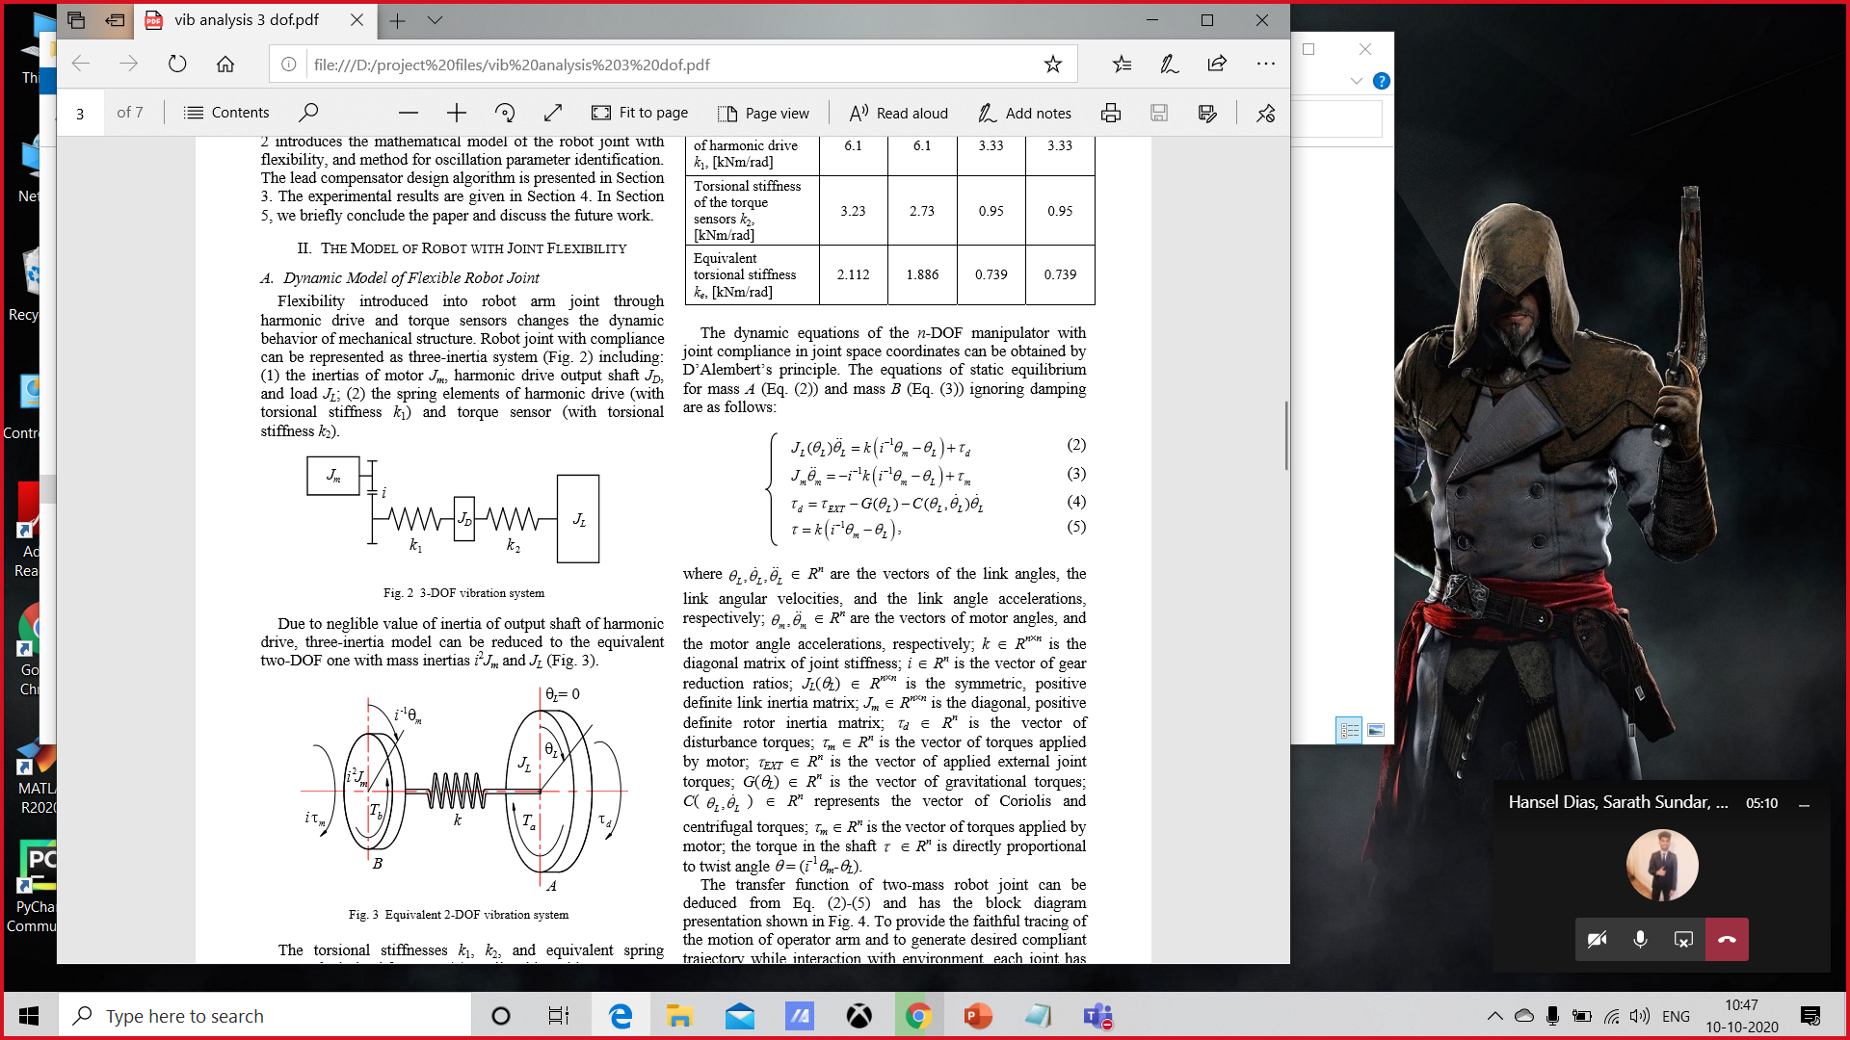
Vibrational Equations.

Slide 20
MATLAB GUI plots for 5 dof arm

Slide 21
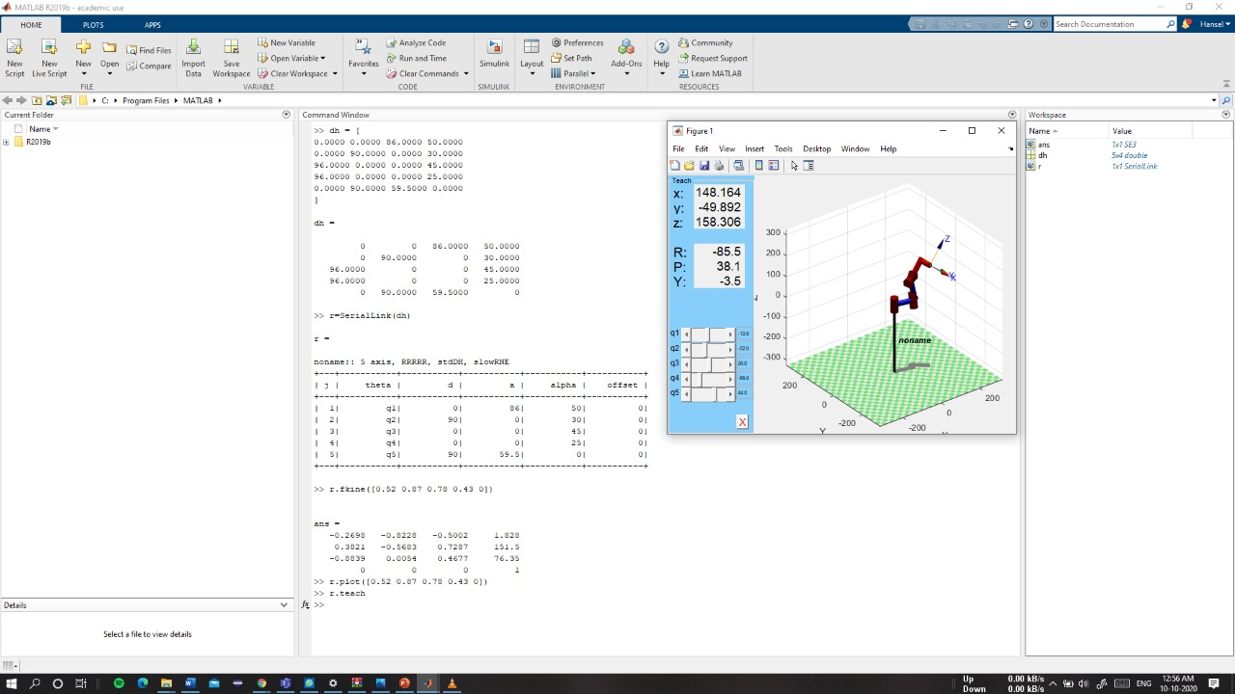

Slide 22
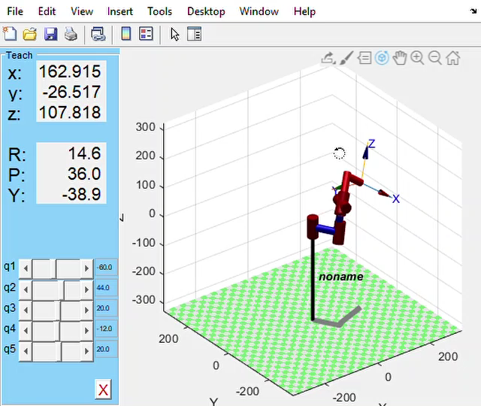

Slide 23
Electronic Simulaton

Slide 24
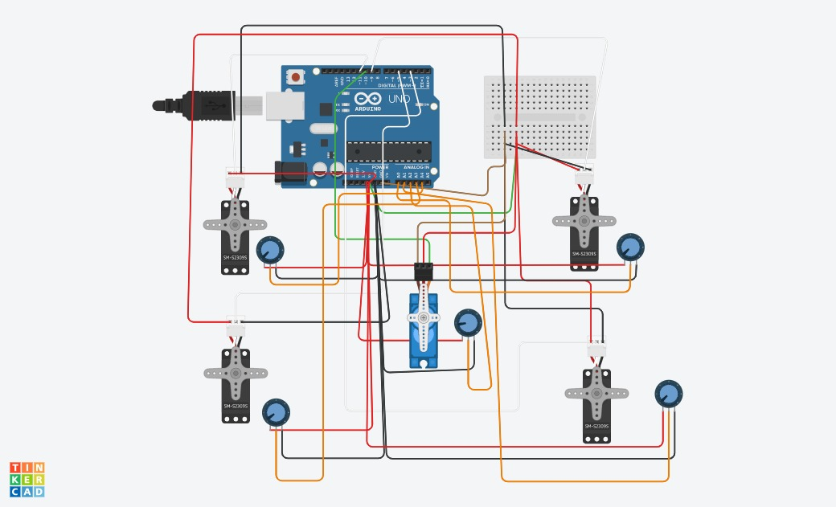

Slide 25
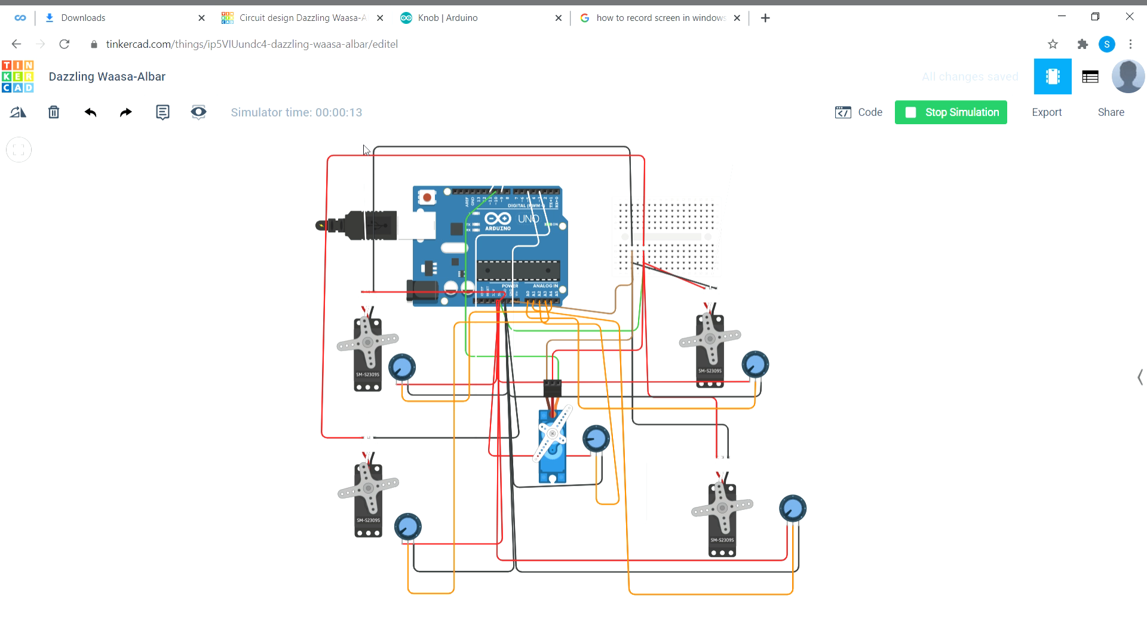

Slide 26
Code for arm simulation

Slide 27
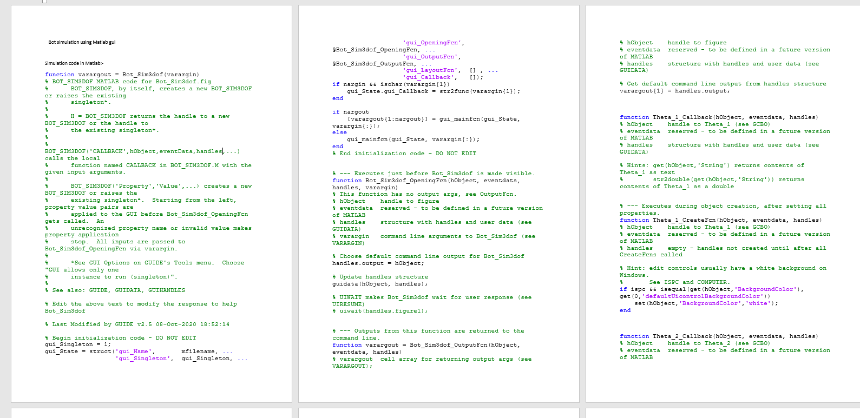

Slide 28
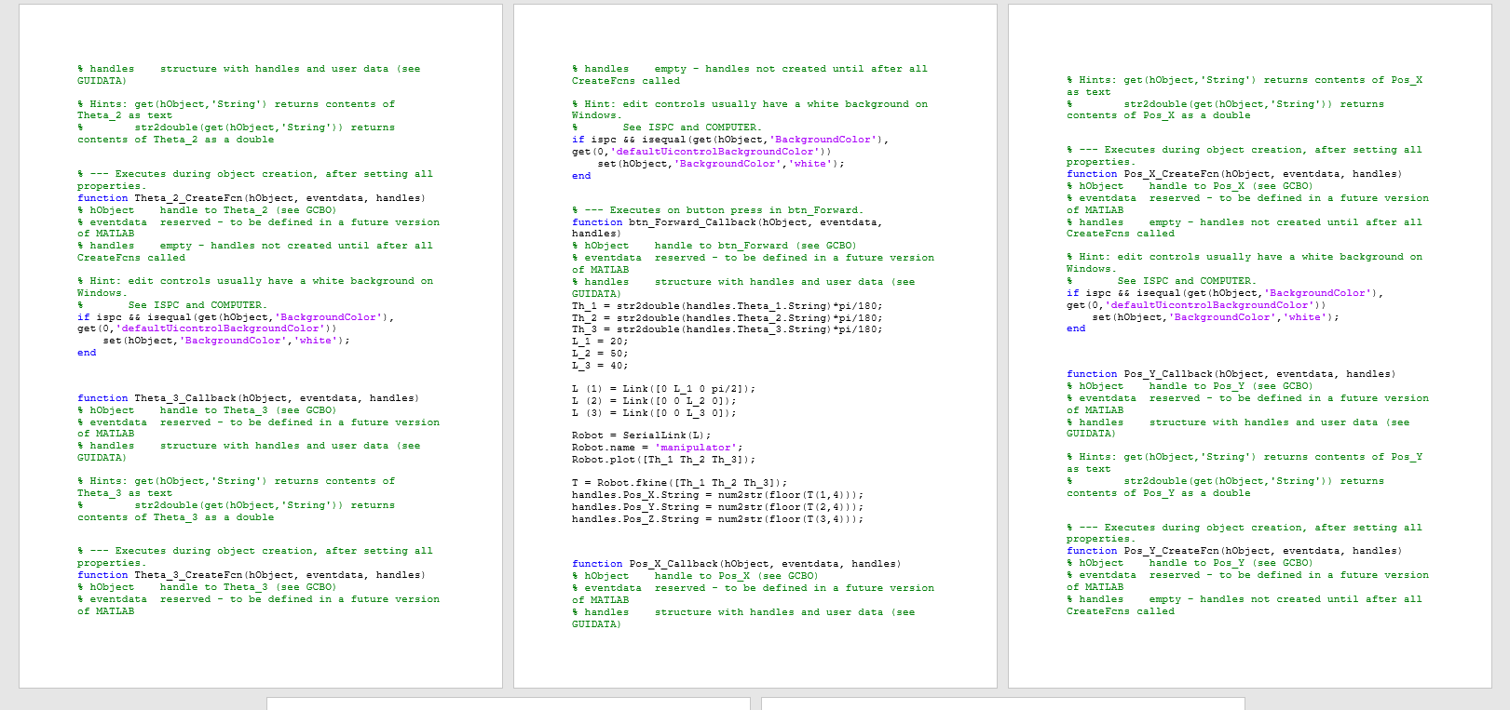

Slide 29
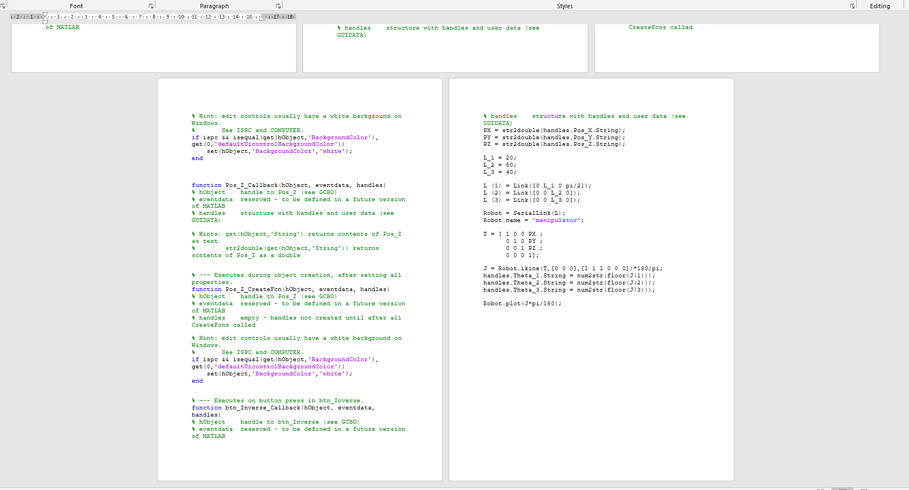

Slide 30
Code for Electronic Circuit Simulation

Slide 31
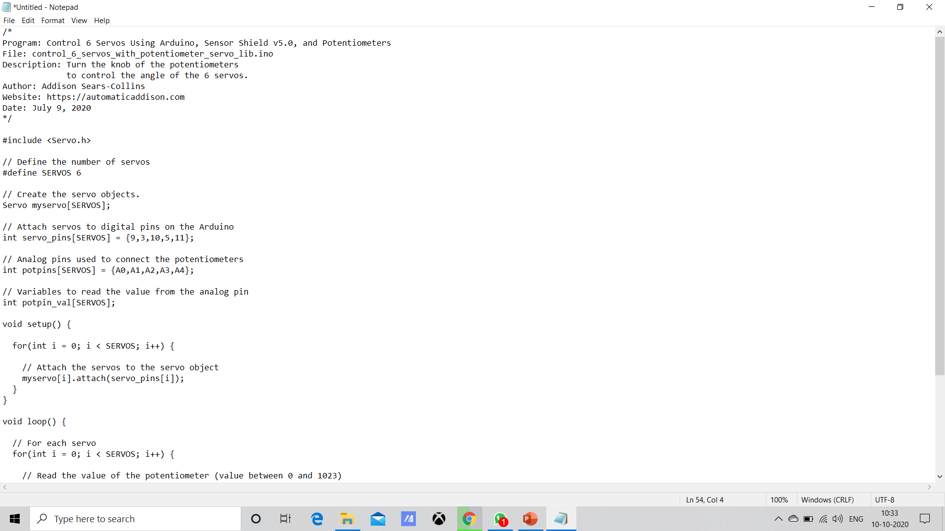
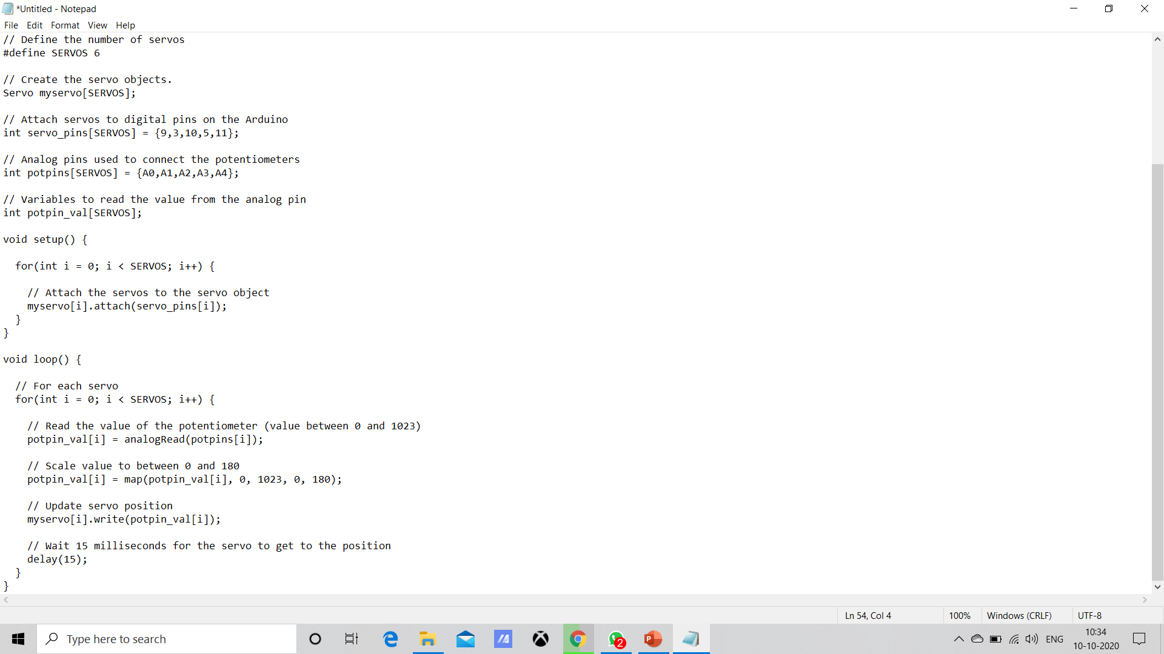

Slide 32
Selection of appropriate techniques and tools
Designing- Solid works 2018
Coding platform/ simulation – MATLAB
E sim- Thinkercad
Medium of reference – eBooks , reference papers, google

Slide 33
Future Work (work for next review)

Slide 34
Tasks Remaining
Importing and Trajectory planning of CAD model
Simulink Model creation.
Angular Accelaration Plot
Trajectory Plot
Torque Plot using MATLAB
Results and discussions

Slide 35
Thank You

